Slide 1



Manifestations of Stigma in the Context of a National Oral Pre-exposure Prophylaxis Scale-up Program in Kenya
¹Daniel Were, ³Kaitlyn Atkins, ¹Abednego Musau, ²Marya Plotkin, ²Kelly Curran, ²Jason Reed
₁ Jhpiego, Kenya ₂ Jhpiego, USA, ₃ John Hopkins Bloomberg School of Public Health

Slide 2
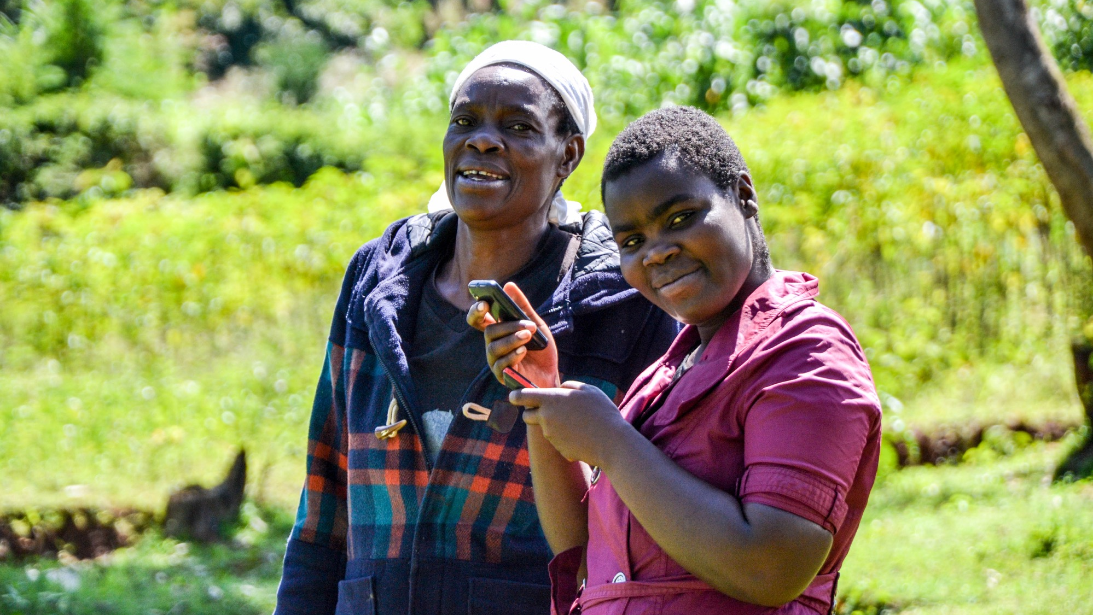


No conflict of interest

Slide 3

Introduction
Kenya included PrEP in national guidelines in July 2016
In May 2017, Kenya launched a national PrEP scale up program
Uptake has been progressive, but slow among some sub populations, and overall continuation rates consistently low
Stigma was documented as a substantial barrier during PrEP clinical trials and demonstration projects
We sought to understand how stigma towards PrEP use is experienced in routine service delivery, in order to improve PrEP outcomes

Slide 4
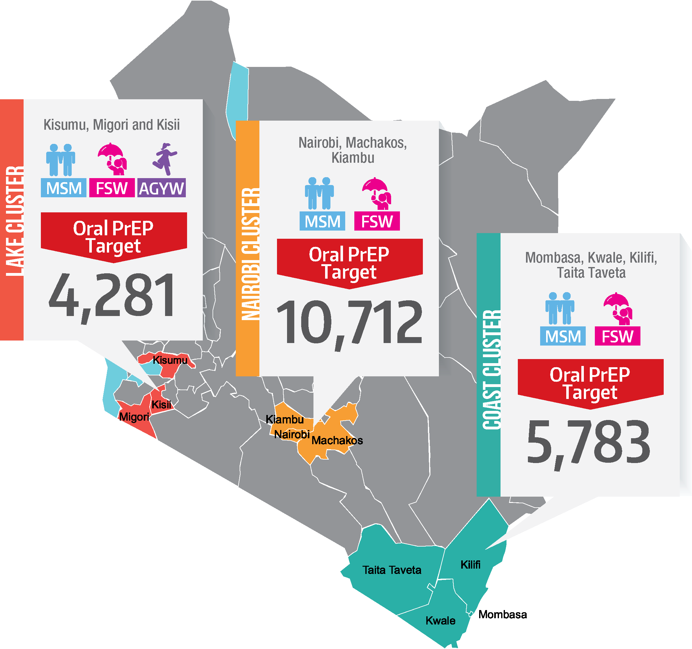
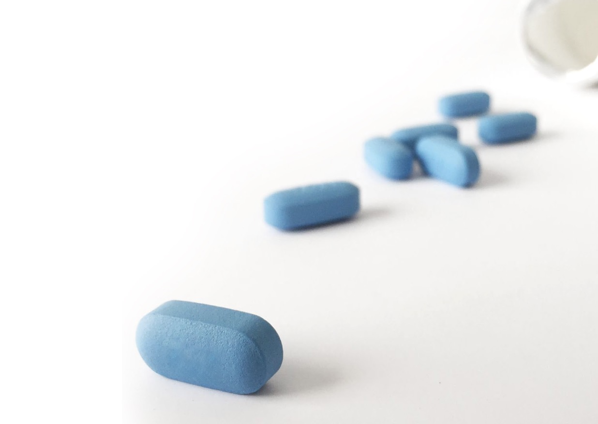


The Jilinde Project
Four year project that seeks to demonstrate effective PrEP integration and delivery at scale, in low resource settings
Implemented in 10 out of 47 counties in Kenya
PrEP provided through 93 sites to:
  Men who have sex with men (MSM)
  Sero discordant couples (SDC)
  Female sex workers (FSW)
  Adolescent girls & young women (AGYW)
  General population (GP)

Slide 5

Methods
A qualitative study associated with Jilinde programmatic scale-up was conducted between October 2017 - November 2018
  22 focus group discussions (FGD) and 30 in-depth interviews (IDIs)
Aim of the study was to understand barriers and facilitators to PrEP uptake and continuation
Ethical approvals were obtained from Kenya Medical Research Institute (KEMRI) and Johns Hopkins Bloomberg School of Public Health (JHSPH), and each participant provided informed written consent
We purposively sampled former, current and potential PrEP users (FSW, MSM, AGYW), parents and sexual partners of AGYW, peer educators, and PrEP health care providers
We conducted thematic data analysis

Slide 6
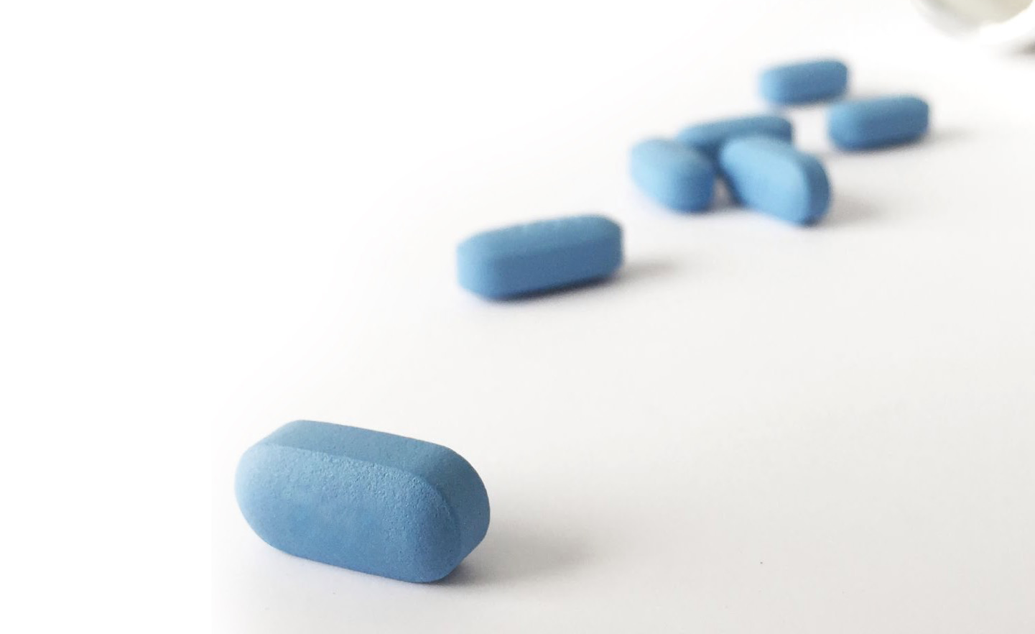
Socio-demographic Characteristics
Population Type | Participants (n=227) | Mean age (Years) | Sex
MSM | 36 (16%) | 26 | All male
FSW | 28 (12%) | 31 | All female
AGYW | 86 (38%) | 21 | All female
Parents of AGYW | 12 (5%) | 44 | 50% were male
Male partners of AGYW | 10 (4%) | 22 | All male
Health care providers | 29 (13%) | 32 | 40% were male
Peer educators (FSW & AGYW) | 26 (12%) | 27 | All female

Slide 7
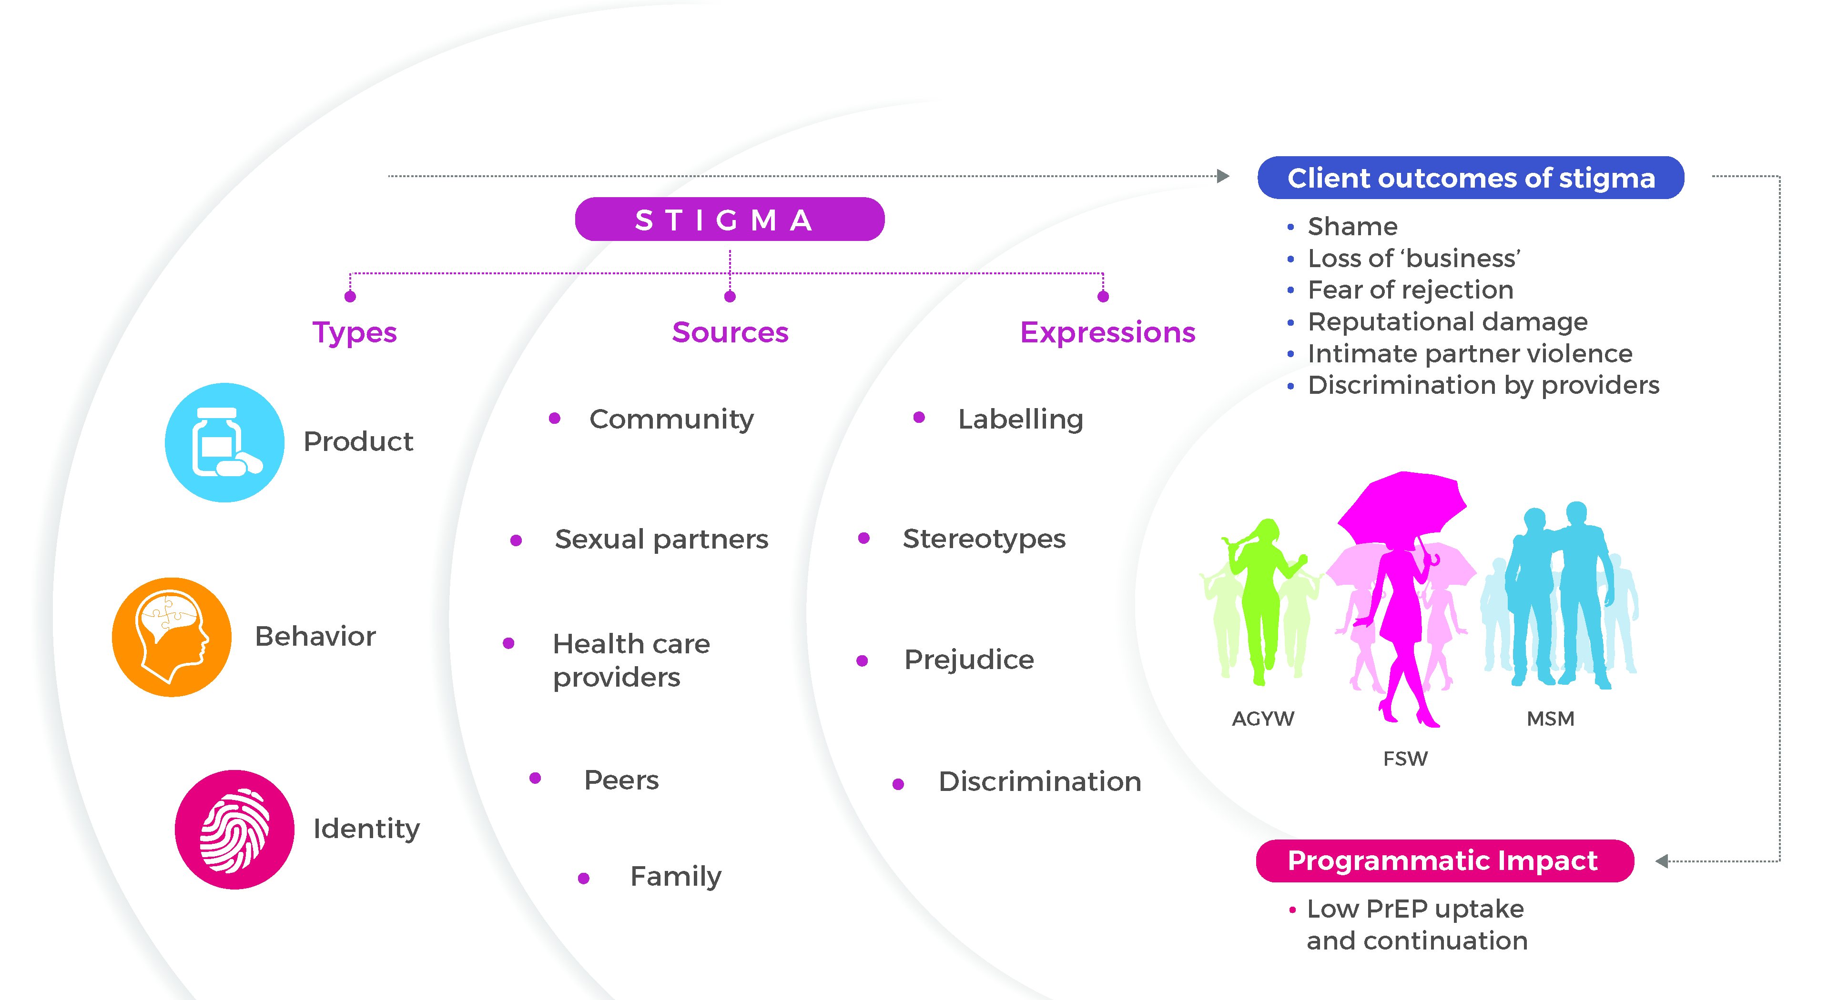
Summary of Key Findings

Slide 8
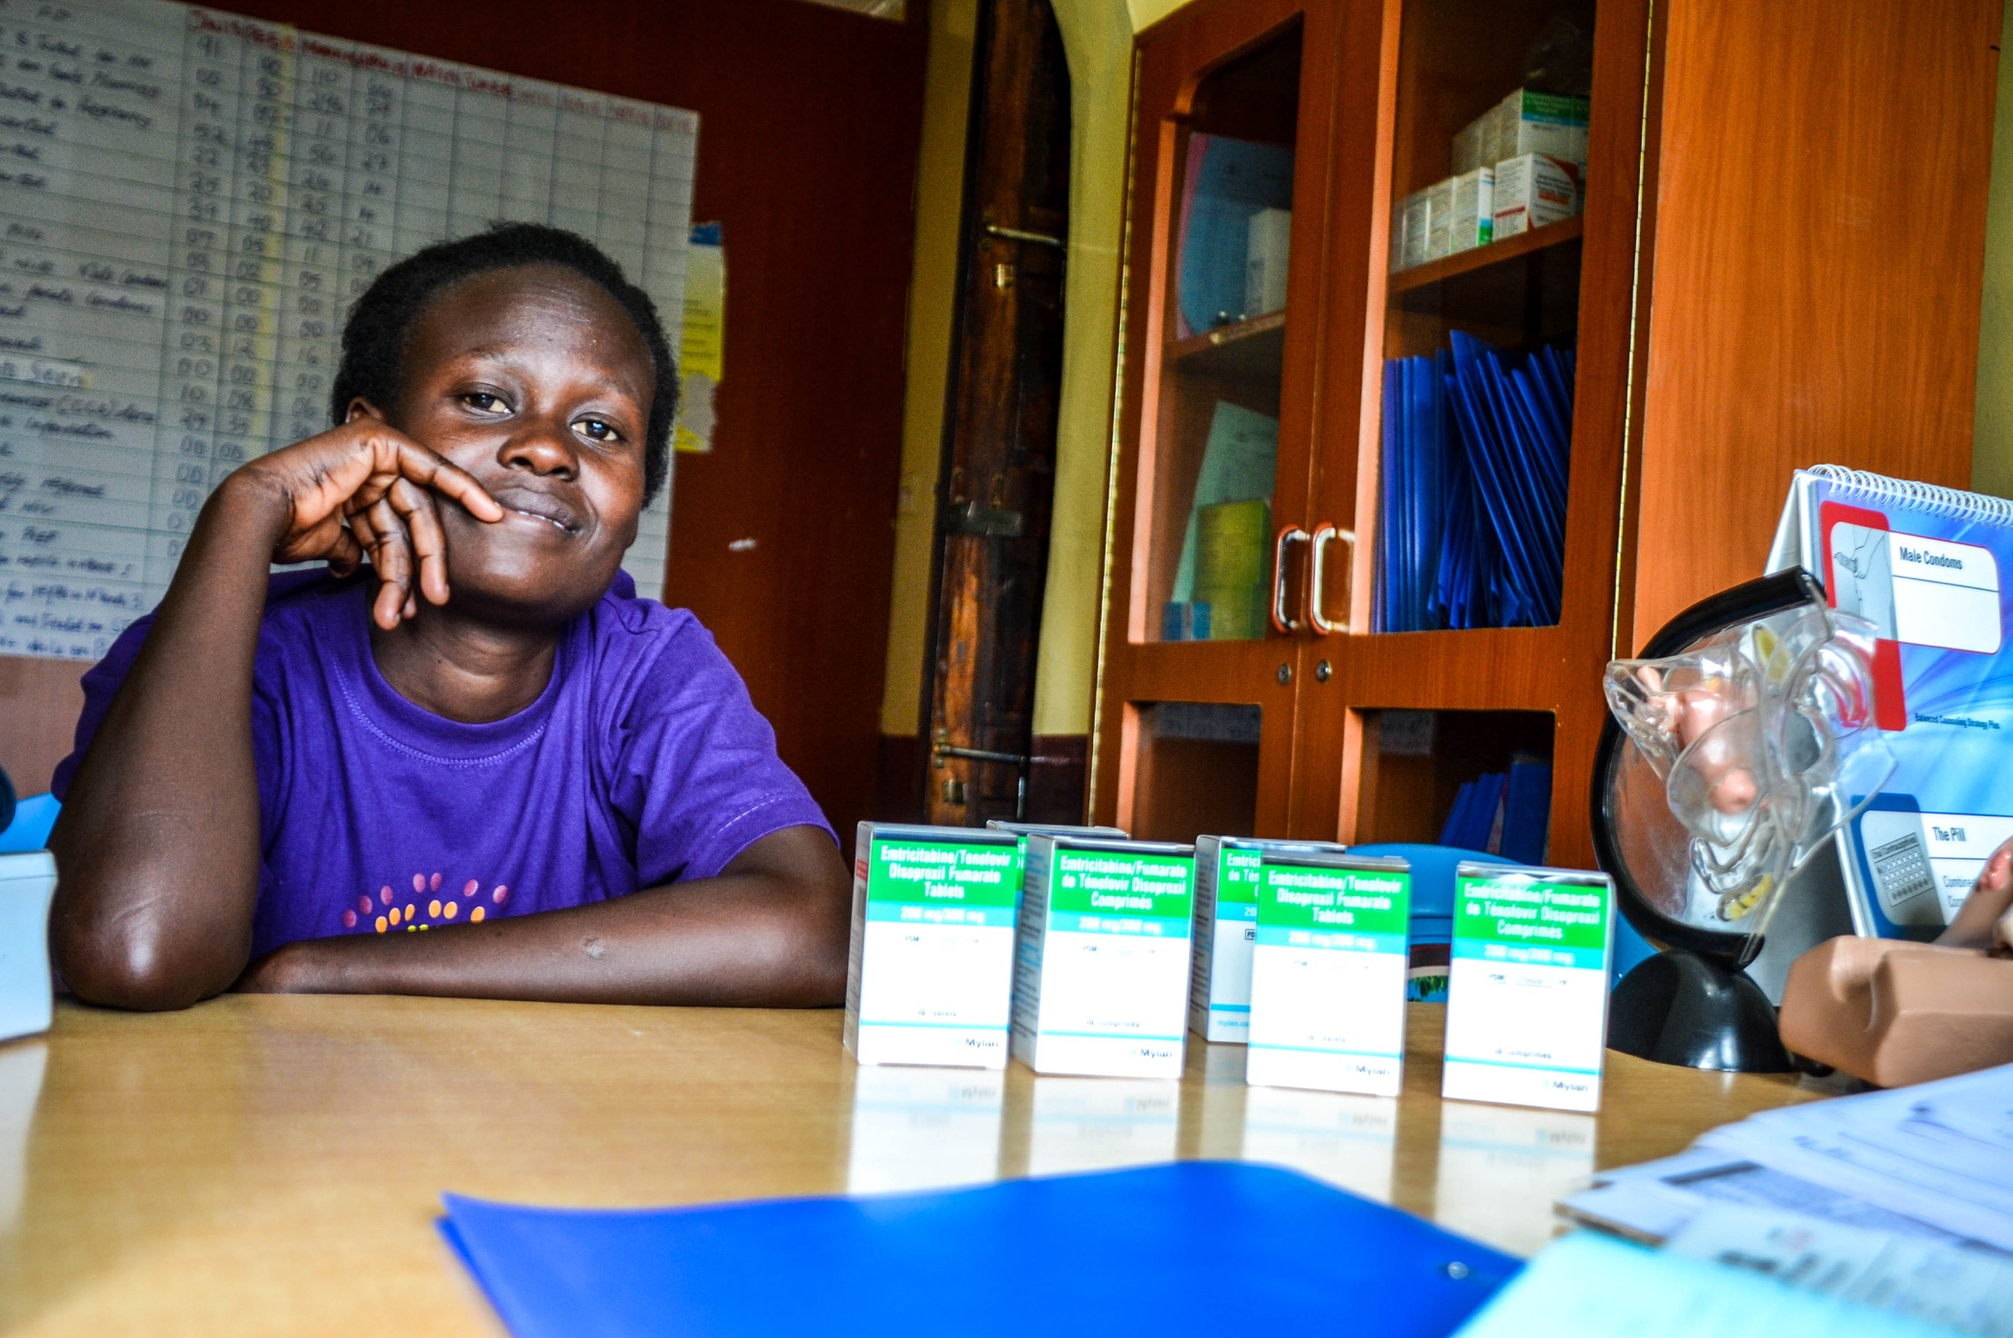

Types of Stigma
1
Product stigma
“I have kept it a secret because the bottle is similar to that of ARVs. Someone who doesn’t know about PrEP could think you have HIV…”
(20 year old, AGYW PrEP user)

Slide 9
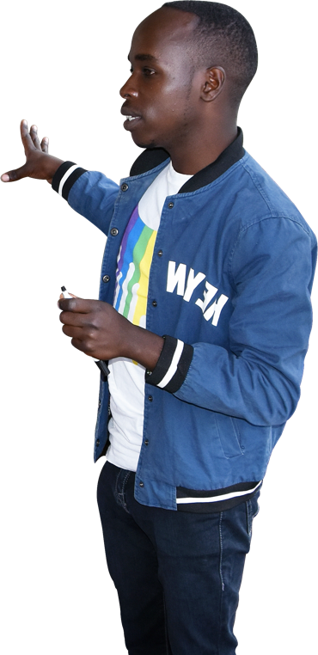

Types of Stigma
“MSM is seen as something bad, they take it as a curse. So when you are near them they reject you. They will be like eeeh… you are a male prostitute…”
(20 year old, MSM PrEP user)
2
Identity stigma
“For male sex workers and MSM, you feel you are serving people you despise. Who wants to deal with these people?”
(33 year old, female clinician)

Slide 10
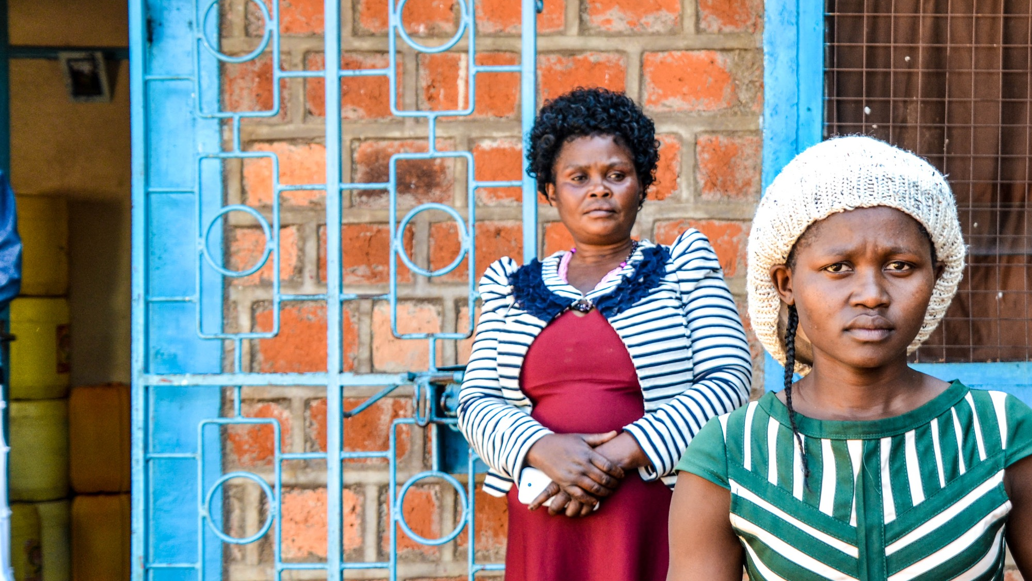
Types of Stigma
3
Behavior Stigma
“My mother told me I have taken those drugs because I want to be a prostitute, so that even if I sleep with men, I don’t get the disease…”
(22 year old, AGYW PrEP user)

Slide 11
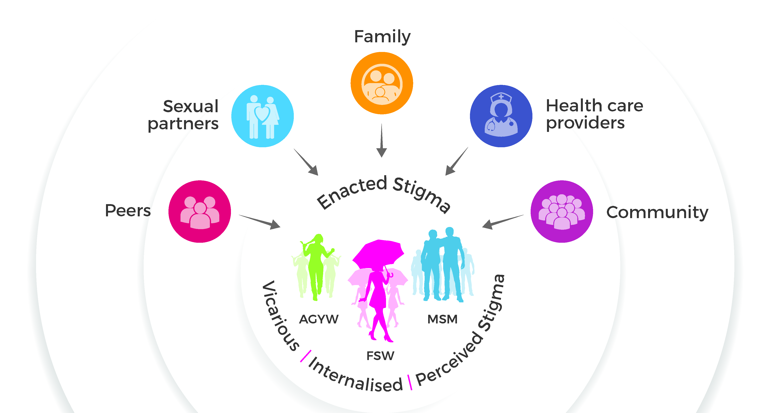


Sources of Stigma

Slide 12


Expressions of Stigma
2
Discrimination
“If you go for a refill, you will wait for so long because some of the clinicians don’t want to see PrEP clients. When they hear that this is a PrEP client, they say, ‘Tell them to wait first’…”
(24 year old, AGYW Peer Educator)
1
Prejudice
“The reality is when the female sex workers come, if she is coming with an STI, you treat but with this attitude of, okay, it serves you right…”
(41 year old, male clinician)

Slide 13
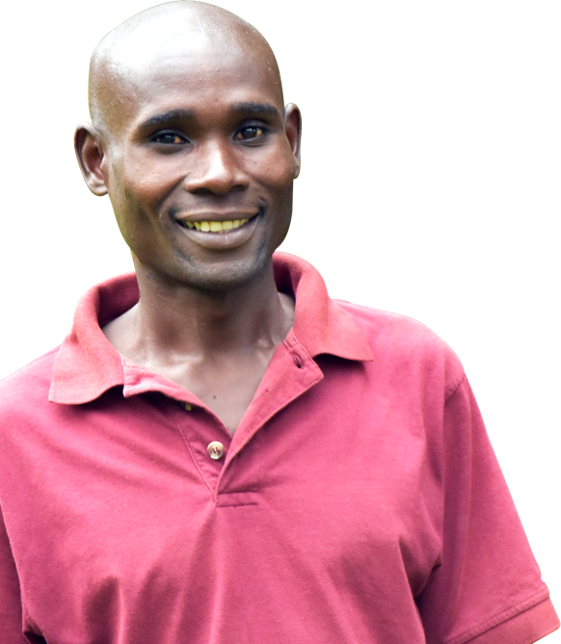

Expressions of Stigma
3
Stereotypes
“I’m really worried of this drug, PrEP, the children will become promiscuous. She will just be having sex with different men to get money...”
(58 year old, parent of AGYW)
4
Labelling
“When you go to the hospital to collect the drug and you meet someone you know, they say… “So you take the HIV drugs, so you have AIDS..”
(22 year old, AGYW, discontinued PrEP)

Slide 14

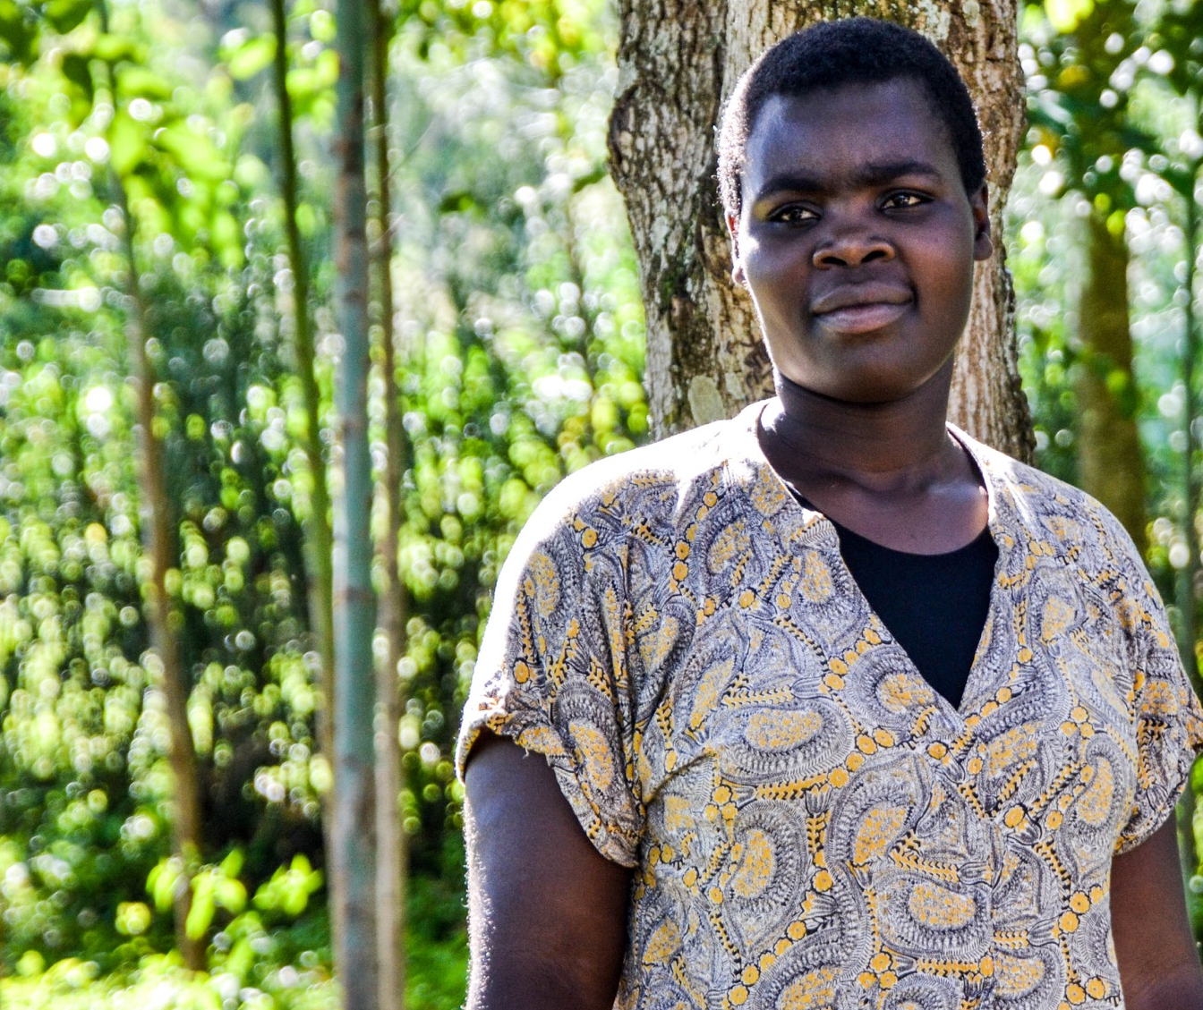
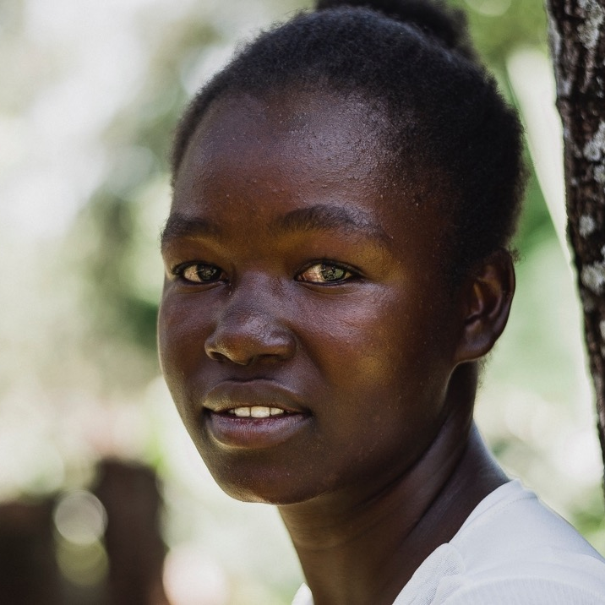

Client Outcomes of Stigma
1
Intimate partner violence
2
Fear of rejection
3
“I had this client who came to my place and my bottle of PrEP was on top of a table. Once he saw this, he dressed up and left the room…”
(24 year old, FSW PrEP user)
Provider discrimination
“I feared how I would tell the old man I was using PrEP because he would beat me.”
(23 yr old, AGYW PrEP user)
4
Loss of business
5
Shame & reputational damage

Slide 15

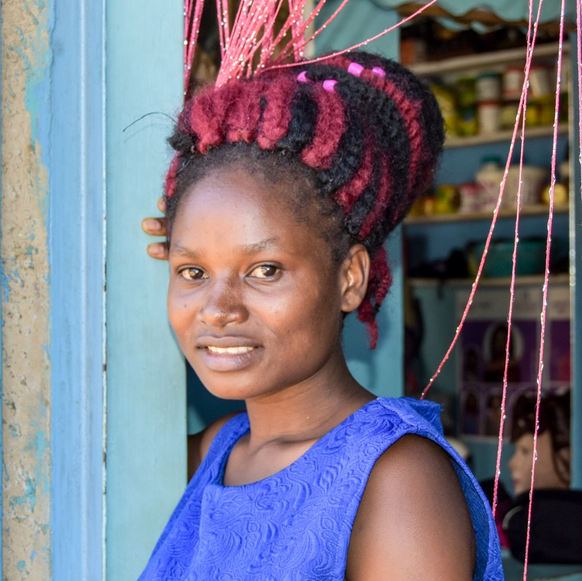
Programmatic
Impact of Stigma
“I stopped when we quarreled with my boyfriend. I had to stop in order to be at peace with him…”
(22 year old, AGYW, discontinued PrEP)
1
Low PrEP uptake & continuation
“What made me to stop taking PrEP was my two friends who said that I was HIV positive…”
(22 year old, FSW, discontinued PrEP)

Slide 16
Conclusion
Stigma was a major contributor to peoples’ choices around initiation and continuation of PrEP;
  Stigma around the product,
  Stigma around clients’ behavior and identity
While stigma was manifested differently for diverse populations, it was described as a major barrier to both uptake and continuation
PrEP delivery programs should:
  Prioritize interventions to address HIV related stigma at all levels, including sensitivity training for providers
  Intensify awareness creation efforts to norm PrEP

Slide 17

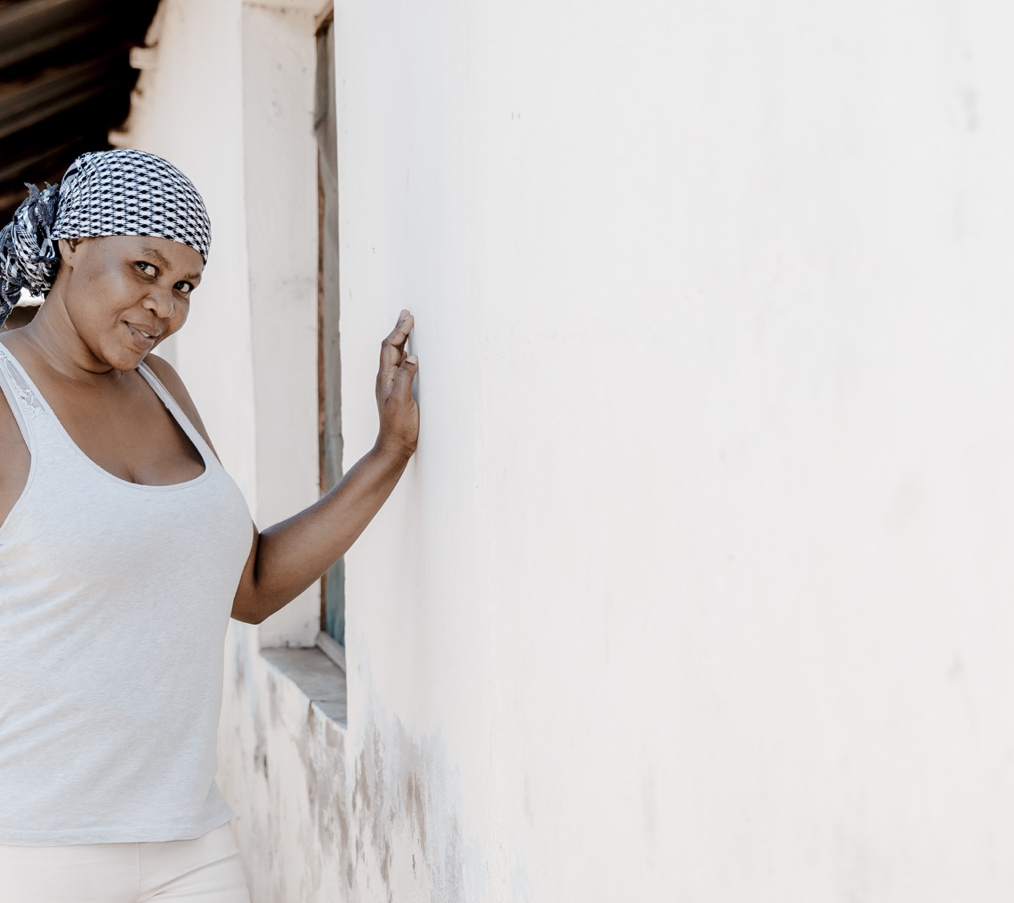
Acknowledgements
Bill & Melinda Gates Foundation
Jilinde Partners (Jhpiego, NASCOP, Avenir Health, PSK, ICRH-K)
National PrEP and Key Populations Technical Working Groups
Gilead Health Sciences
US President’s Emergency Plan for AIDS Relief (PEPFAR)
LINKAGES, GEMS and OPTIONS projects
Prevention Market Manager (AVAC & CHAI)
Partners Scale Up Project
Ministry of Health and County governments in Kenya
Local Implementing Civil Society Organizations

